Slide 1
Data Science: Medical Field

Slide 2
What is Data Science?
Data Science is the process of collecting, analyzing, and interpreting large amounts of data.
Data Science is transforming the medical field by making healthcare smarter, faster, and more accurate.
It uses statistics, programming, and machine learning
To improve patient care
To reduce cost
To support doctors in decision-making

Slide 3
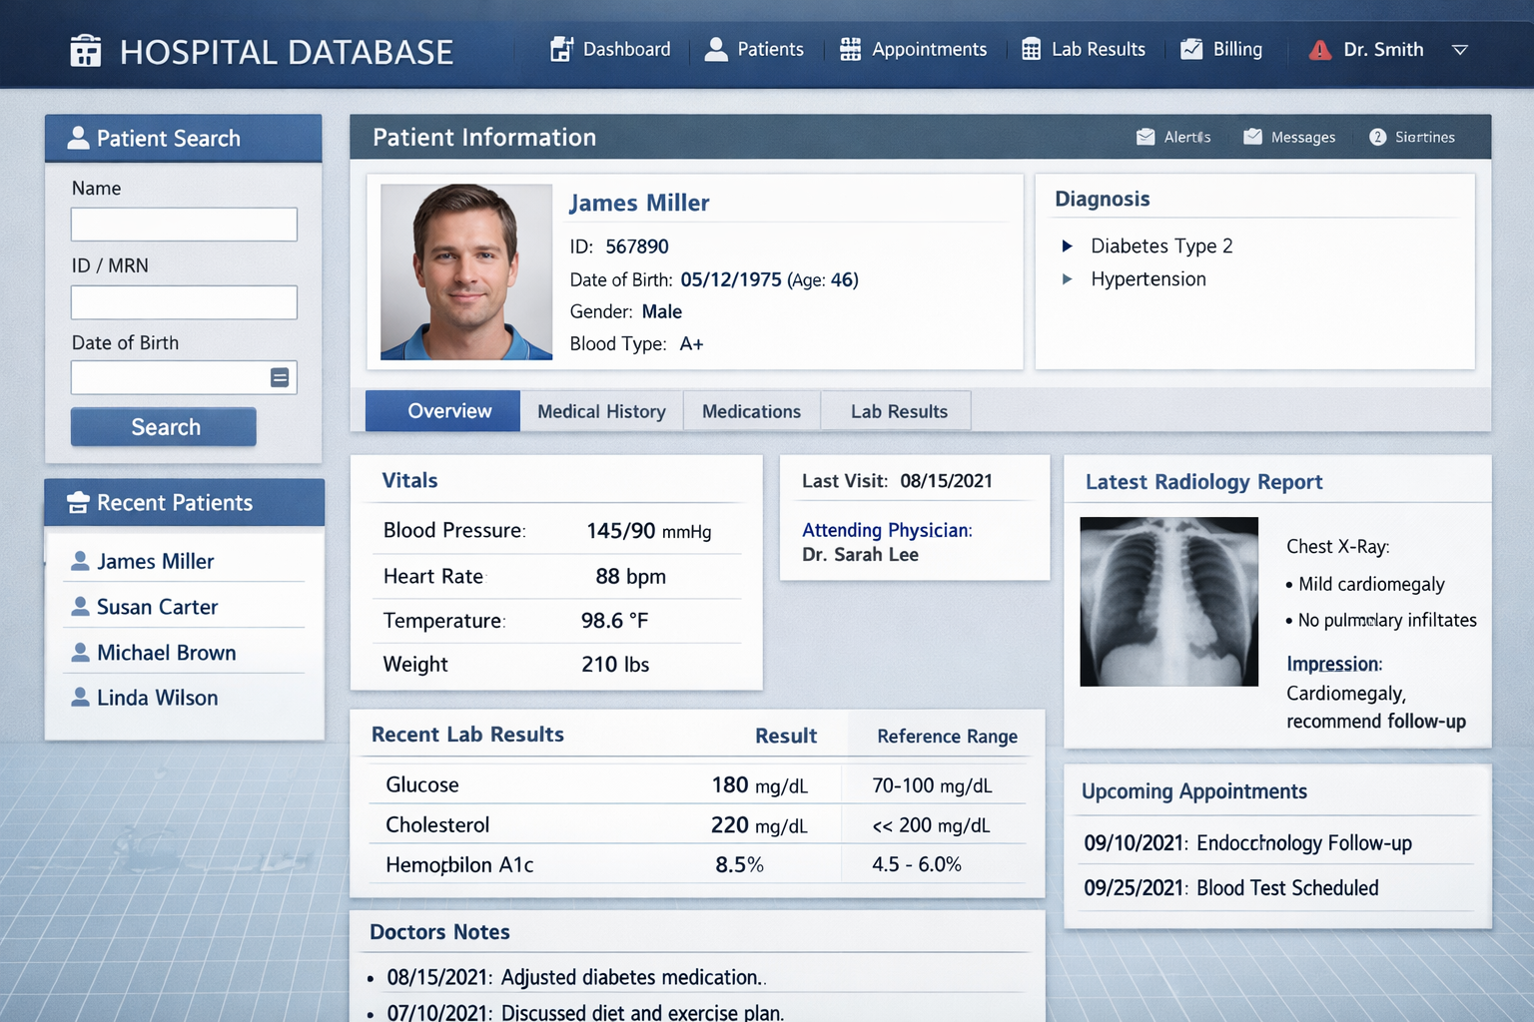
1. Sources of Medical Data
Electronic Health Records (EHR)
Medical images (X-ray, MRI, CT scan)
Lab test reports
Wearable devices (heart rate, BP, sugar)
Clinical trials data

Slide 4
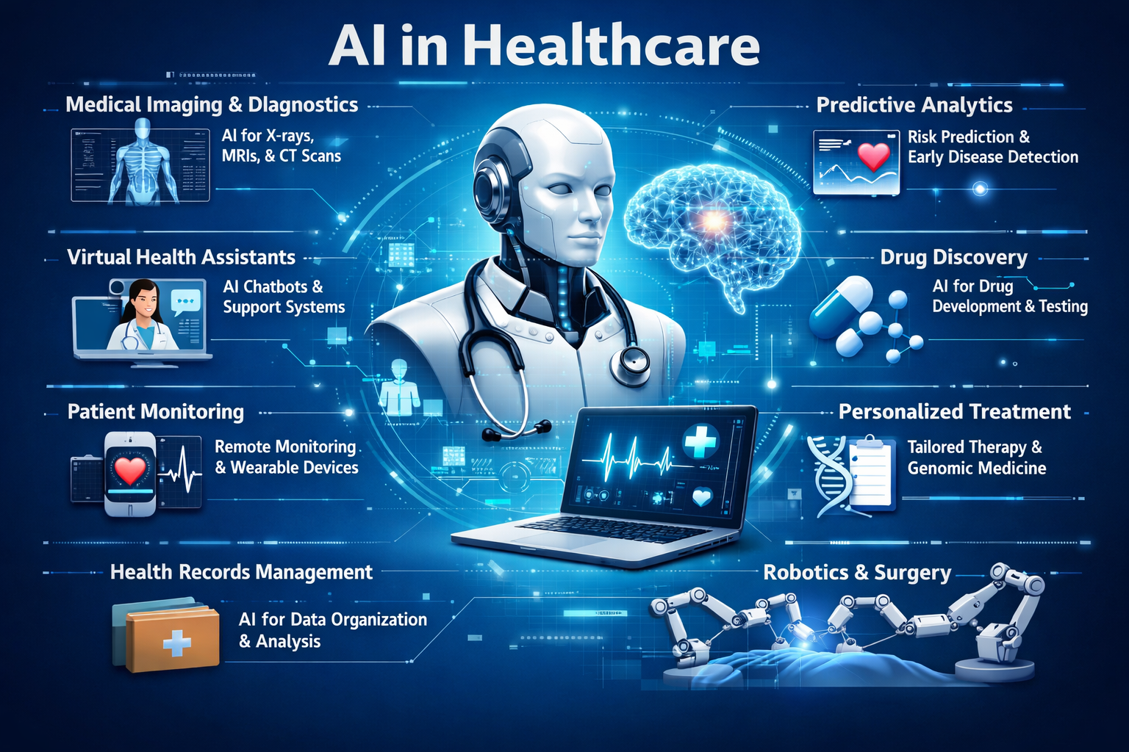
2. Applications of Healthcare
Disease prediction
Medical image analysis
Drug discovery
Personalized treatment
Hospital management

Slide 5
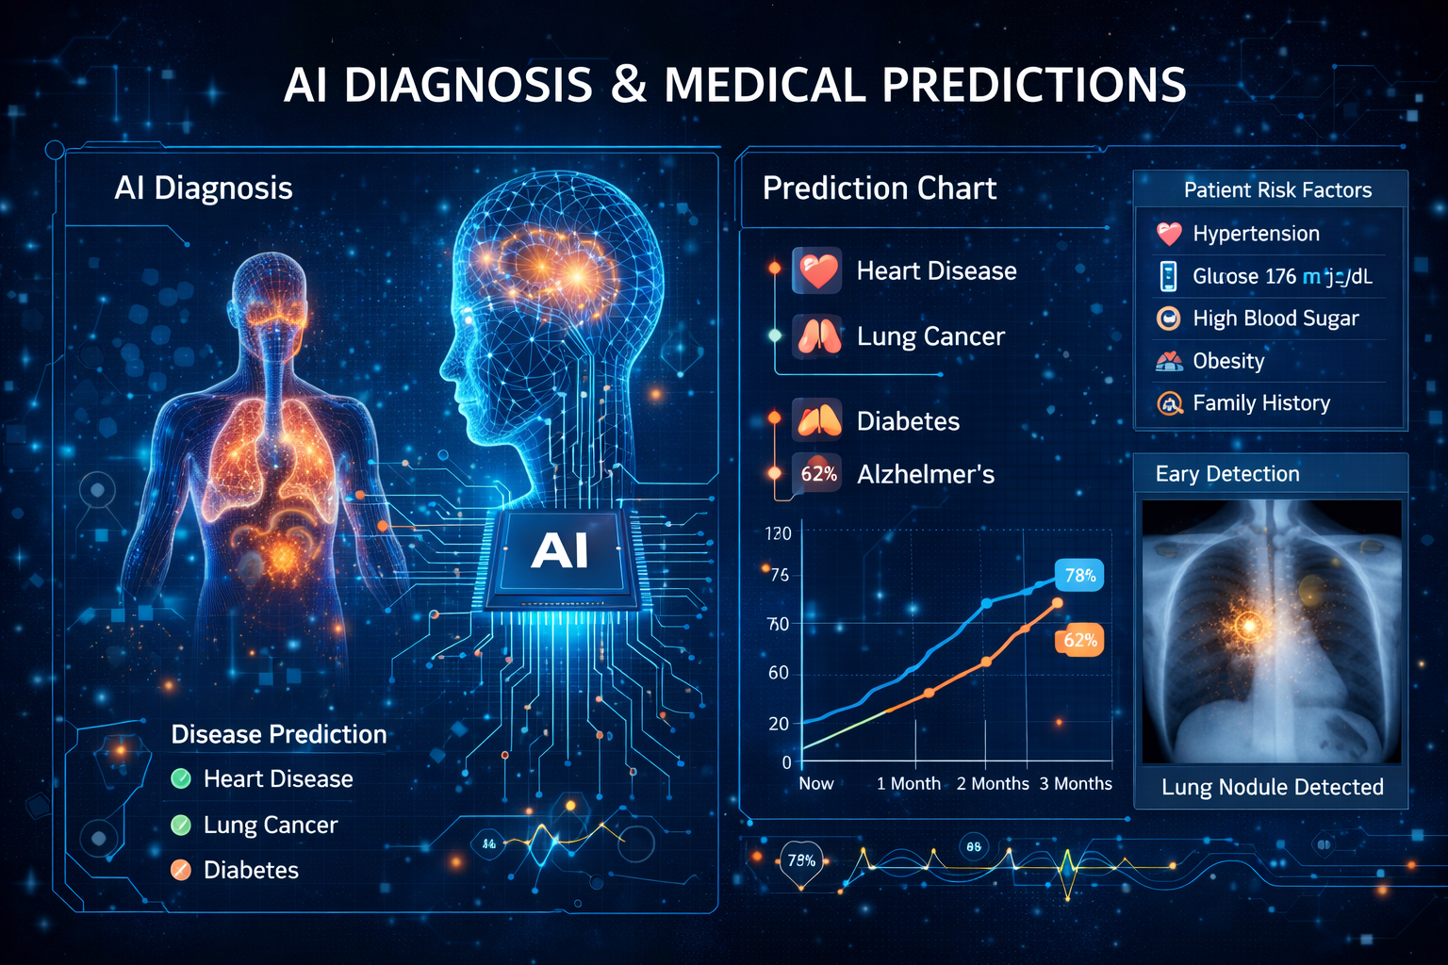
3. Disease Prediction & Diagnosis
Predict diseases like diabetes, cancer,
heart disease
Uses patient history and test data
Early diagnosis saves lives
Example:
Predicting diabetes using sugar level,
age, weight

Slide 6

4. Real Life Examples
Cancer detection using AI
Heart disease prediction
COVID-19 data analysis
Heart disease risk prediction
Diabetes prediction and monitoring
Predicting ICU patient outcomes
Personalized treatment recommendations
Early detection of cancer using patient data

Slide 7
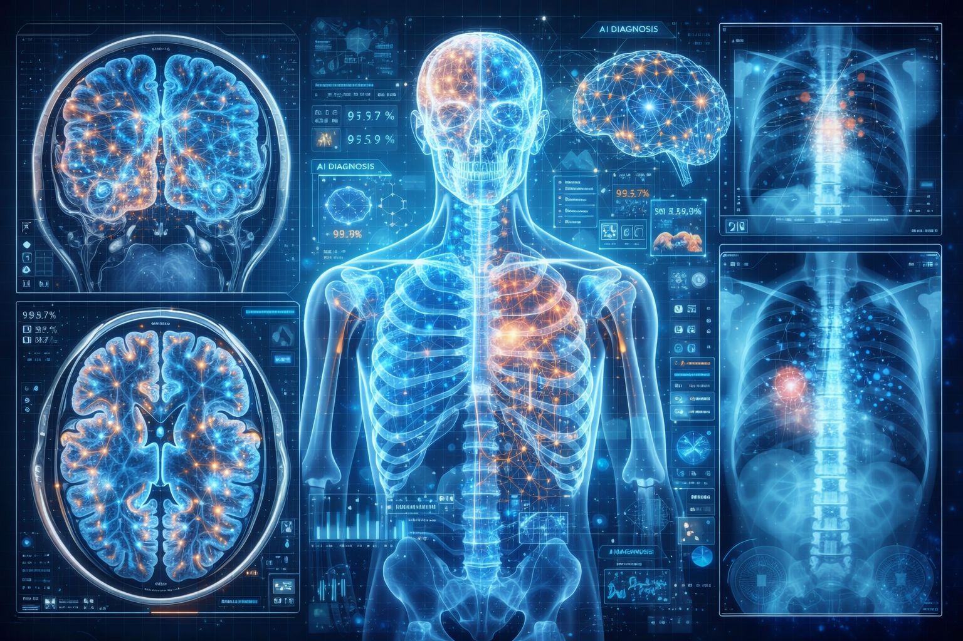
5. Medical Imaging & AI
AI analyzes X-ray, MRI, CT scan images
Detects cancer, tumors, fractures
Faster and more accurate results
Used by:
Radiologists
Hospitals

Slide 8
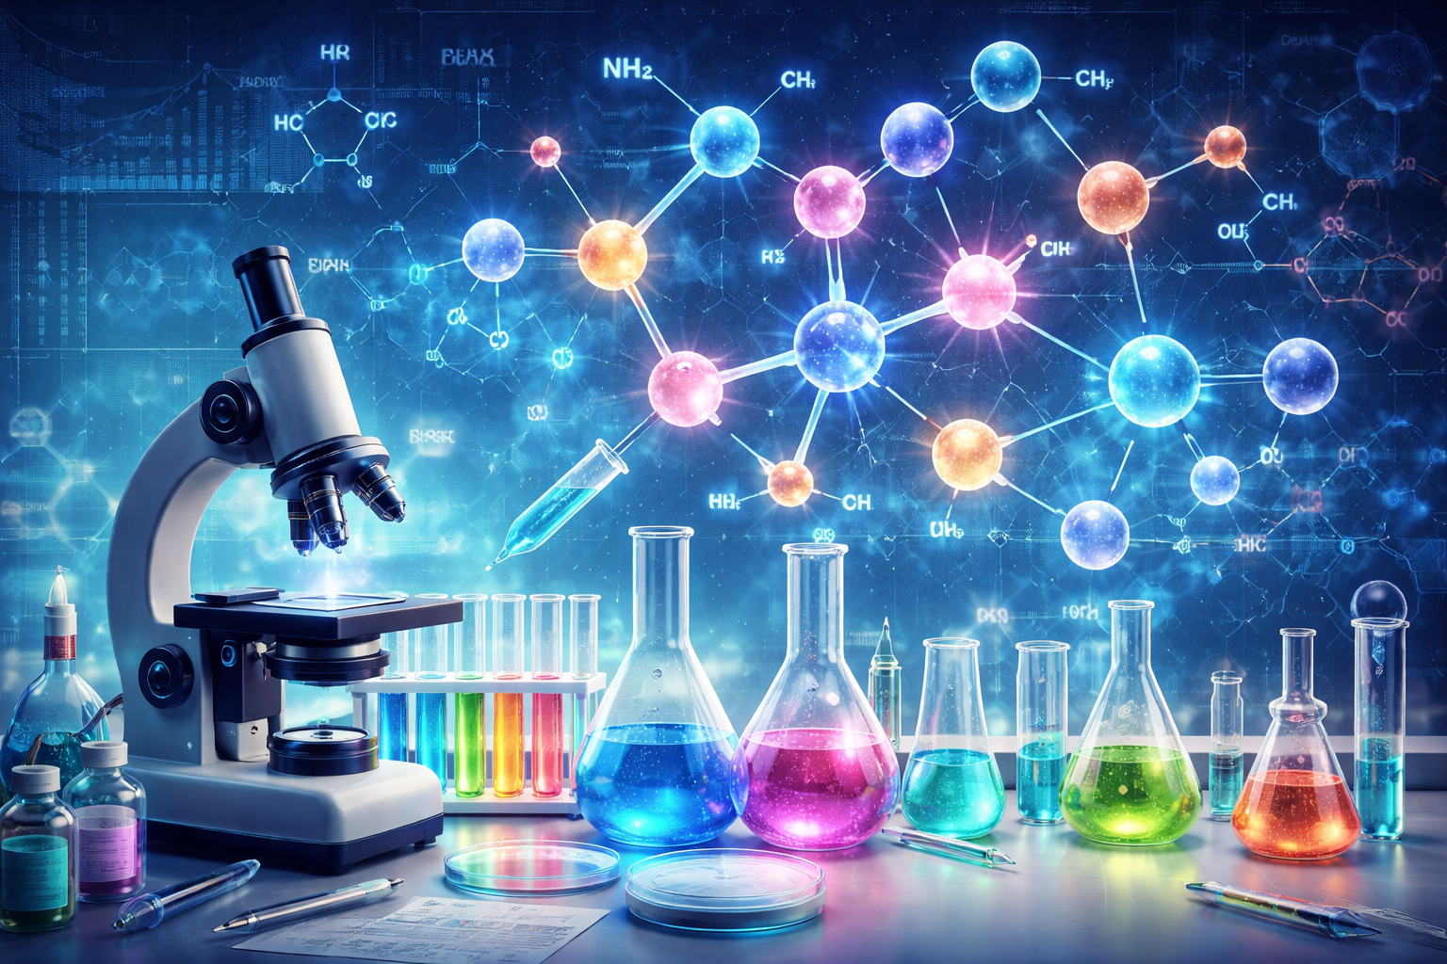
6. Drug Discovery & Research
Analyze chemical data
Reduce time and cost of drug development
Used in COVID-19 vaccine research
Reduce research time
Support clinical trials
Improve drug success rate
Enable drug repurposing

Slide 9
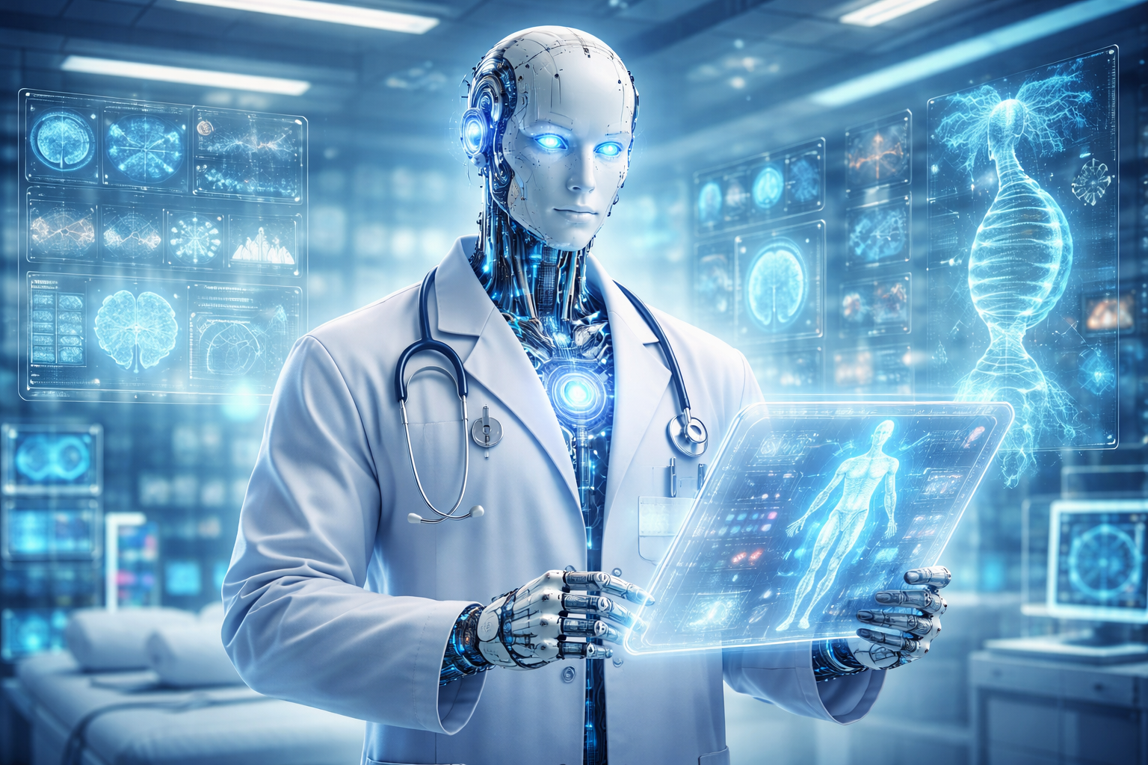
7. Benefits & Future Scope
Better treatment
Early disease detection
Cost reduction
Future Scope:
Smart hospitals
AI doctor's assistant
Personalized medicine

Slide 10
Thank You

